Slide 1
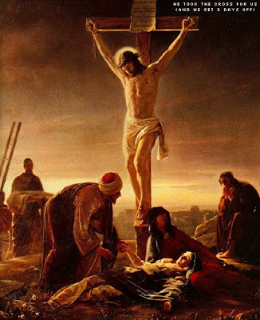
Jesus died on the cross for our sins
Lesson 3.2
Ages: 1-5, 6-7, 8-13
TOPIC- EASTER
MARCH 2021 – WASHINGTON REGION LITERATURE COMMITTEE

Slide 2
Objective
After completing this lesson, the children should have a better understanding of crucifixion and the meaning behind Jesus' death on the cross.

Slide 3
Memory Verse
Philippians 2:8 NIV
And being found in appearance as a man, he humbled himself by becoming obedient to death, even death on a cross!"
Amen!

Slide 4
Memory Verse
John 3:16
“For God so loved the world that he gave his one and only Son, that whoever believes in him shall not perish but have eternal life.

Slide 5
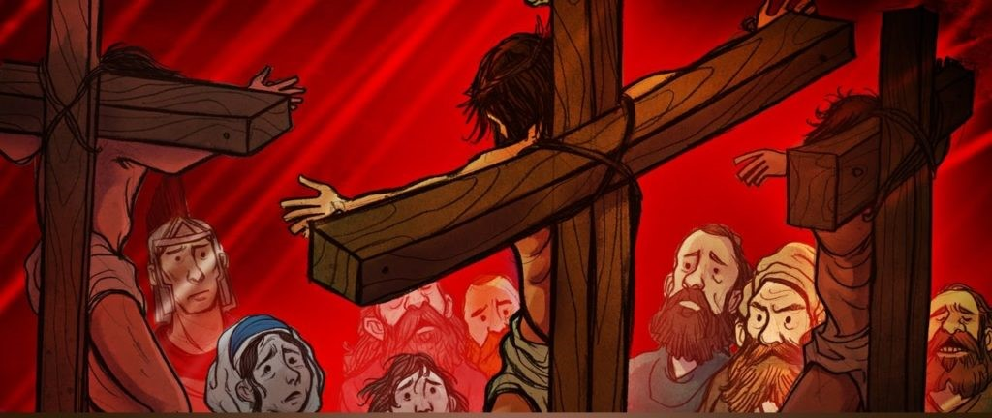
Scripture Reading:
Matthew 27:1-56; Mark 14:53-15:41; Luke 22:54-23:49; John 18:12-19:37
The Bible teaches us in Ephesians 1:7 that it is through Jesus’ blood that we find redemption and the forgiveness of sins. But more than our forgiveness and redemption, the story of the cross is the story of God’s love. As John 3:16 so famously declares “For God so loved the world that he gave his one and only Son, that whoever believes in him shall not perish but have eternal life.

Slide 6
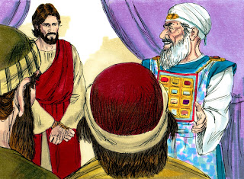

Slide 7
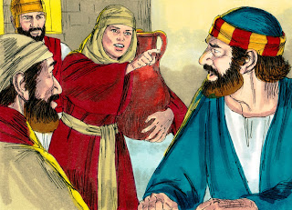

Slide 8
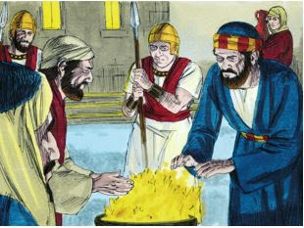

Slide 9
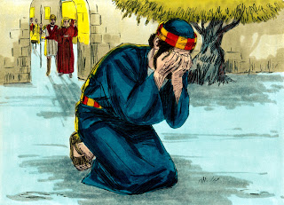

Slide 10
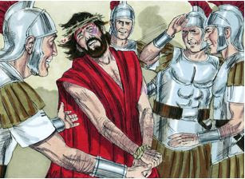

Slide 11
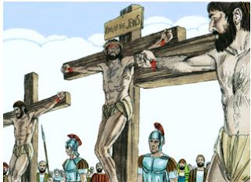

Slide 12
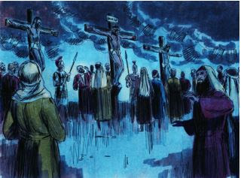

Slide 13
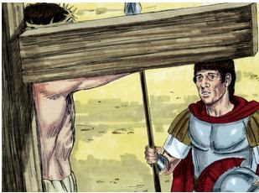

Slide 14
Video
https://www.youtube.com/watch?v=IH0vBClMk5A&feature=emb_logo
Video Resource: ShareFaith Kids

Slide 15
Discussion Questions
While Jesus was being questioned by Annas, which of His disciple followed Him?
How times did Peter denied Jesus?
Who is Simon of Cyrene and what lesson(s) can we learn from him?
What sign did they put above the cross of Jesus?

Slide 16
Discussion Questions
Who are the two criminals and what lesson(s) can we learn from them?
What did one of the thieves who was next to Jesus said to Him?
What happened when Jesus died on the cross?

Slide 17
Discussion Questions
The importance of forgiveness.
What did Jesus say about forgiveness?
For whom did Jesus on the cross?

Slide 18
Questions?

Slide 19
Memory Verse
Philippians 2:8 NIV
And being found in appearance as a man, he humbled himself by becoming obedient to death, even death on a cross!"
Amen!

Slide 20
Memory Verse
John 3:16
“For God so loved the world that he gave his one and only Son, that whoever believes in him shall not perish but have eternal life.

